Slide 1

Identification and localization of PCB defects using computer vision
Maimoona butt
Supervised by: Dr Alkan

Slide 2
Introduction
PCB’s?
Why defect detection important in manufacturing
Limitations of manual inspection
Deep learning for automating PCB defect detection

Slide 3
Research Aim and Objective
System capable of detecting defects in printed circuit boards using specified convolutional neural networks
Overcome shortcomings in classical approaches for detection of defects in printed circuit boards using CNN
To inspect the performance of learning algorithms using the relevant evaluation methods
The study aims to design reliable fast and accurate method for identifying and categorizing defects to meet industrial demand in manufacturing

Slide 4
Literature Review
Manual and Early Machine Learning Methods
Support Vector Machines (SVM) and Random Forests (RF) were introduced (Volkau et al., 2019)
Deep Learning and CNN-Based Approaches
CNNs provided more accurate feature extraction and could handle the complexity of PCB images much better than traditional machine learning (Hu & Wang, 2020; Kang et al., 2022). Bhattacharya & Cloutier (2022) showed a 98.1% detection rate using YOLO and ResNet50 architectures.
Hybrid and Advanced Deep Learning Approaches
hybrid approaches combining deep learning with classical methods, such as the integration of CNNs with Siamese networks or transformer-based models (Z. Ling et al., 2022; An & Zhang, 2022).
advanced models like skip-connected autoencoders and the LPViT transformer model, improving both accuracy and speed in detecting defects in more complex PCBs (Kim et al., 2021; Hu & Wang, 2020). Nguyen & Bui (2022), proposed combining deep learning with techniques like ORB and RANSAC for more precise defect identification in real-time manufacturing environments.

Slide 5
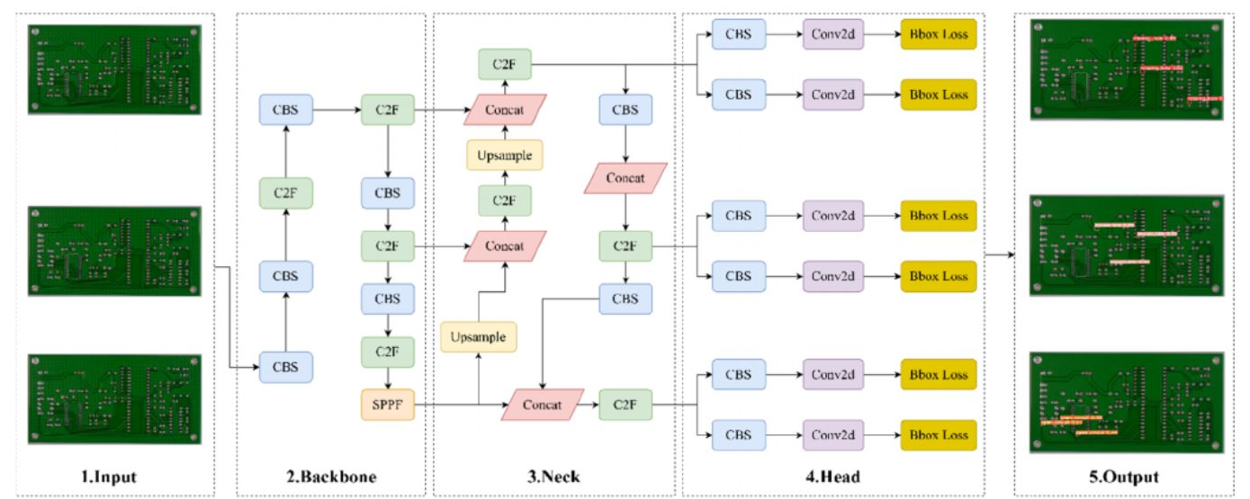
Model Architecture

Slide 6
Research Methodology
• Dataset Loading
2GB Kaggle dataset
google Colab
images & annotations
• Data Preprocessing & Augmentation
parsing xml files
resize images
resize annotations
• Making Feature Vectors for YOLO
correct labels to the feature vectors
"one-hot" notation
numerical vectors that are then matched to their labels
Data Slicing

Slide 7
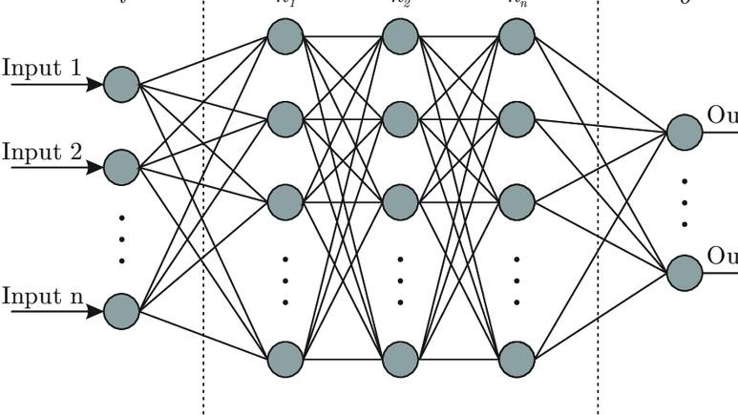
Conti..
• Initialising Neural Network
Convolutional Layers (detect feature in images)
Pooling Layers (reduce size of images)
Connected Layers (final decisions to classify object in images )
Pre-Trained Models (provide inputs)
• Compiling the Neural Network
Optimization approach
Loss function
Target Metrics

Slide 8
Model Training
Hyperparameter | Value
Batch Size | 16
Image Size | 640
Mixup | 0.3 (blend of the two original images)
Save Period | 1
Epochs | 180 (For YOLO v8) 100 (For YOLO v9)
Color Channels | 3
Learning Rate | 0.001
Optimiser | Adam (improve how a model learns)
Loss Function(s) | Box Loss, Class Loss, DFL Loss
Target Metric | Mean Average Precision (mAP)

Slide 9
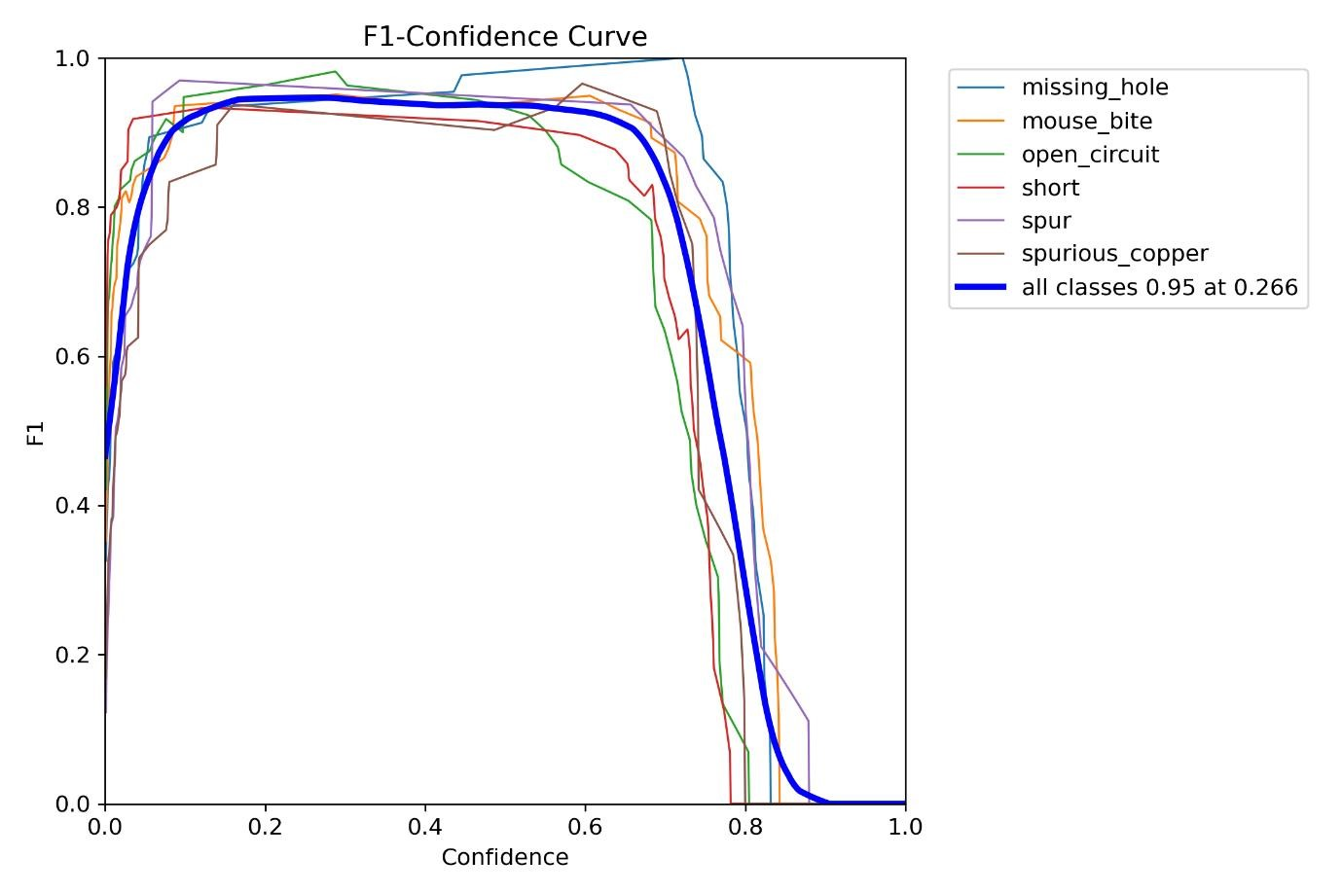
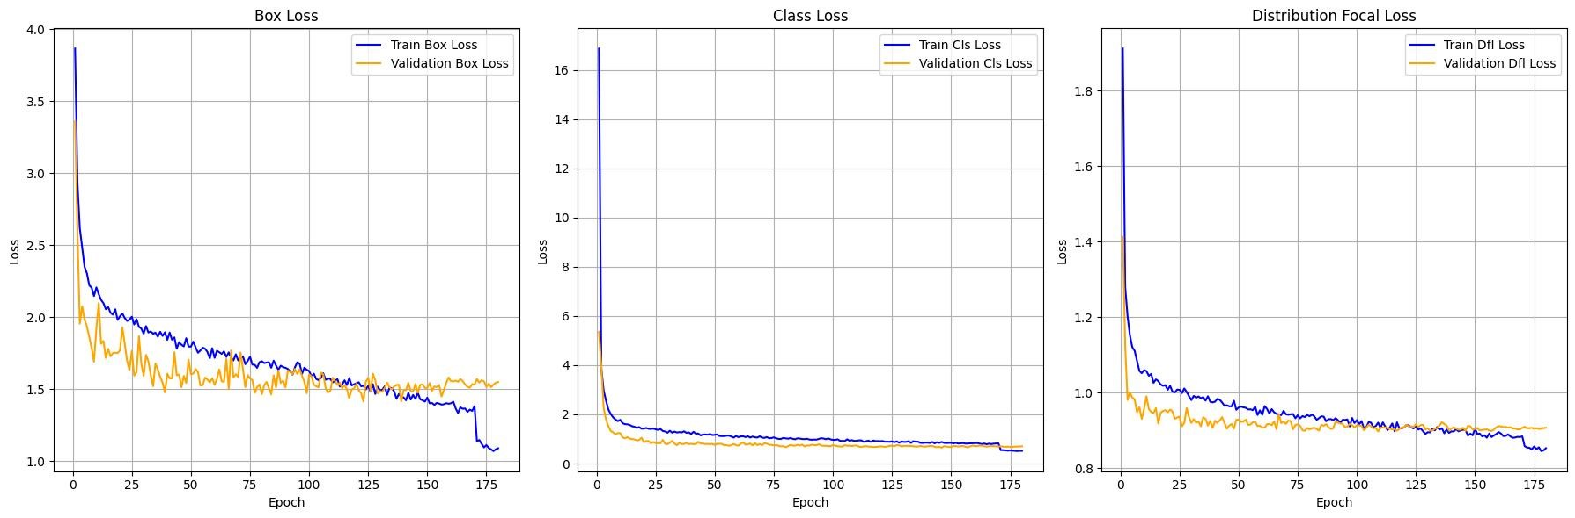
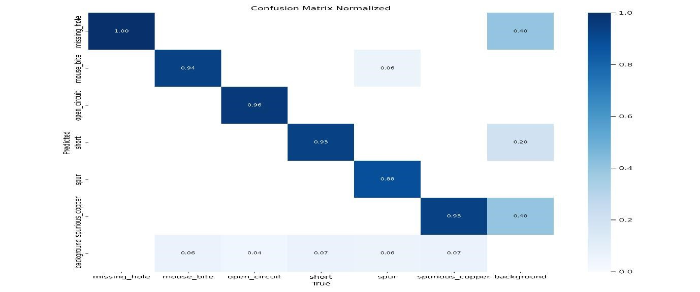
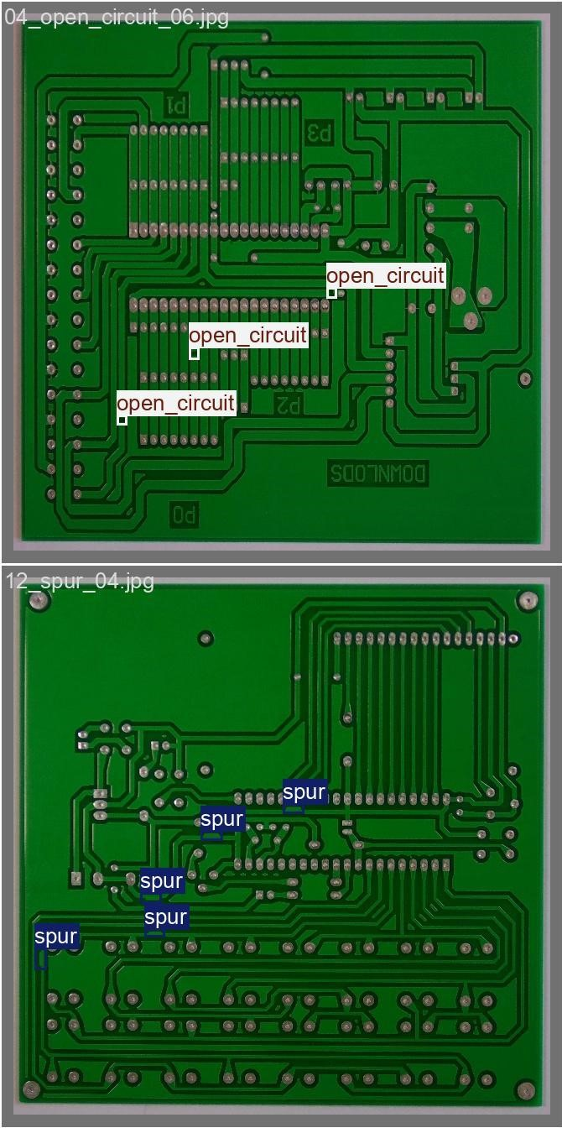
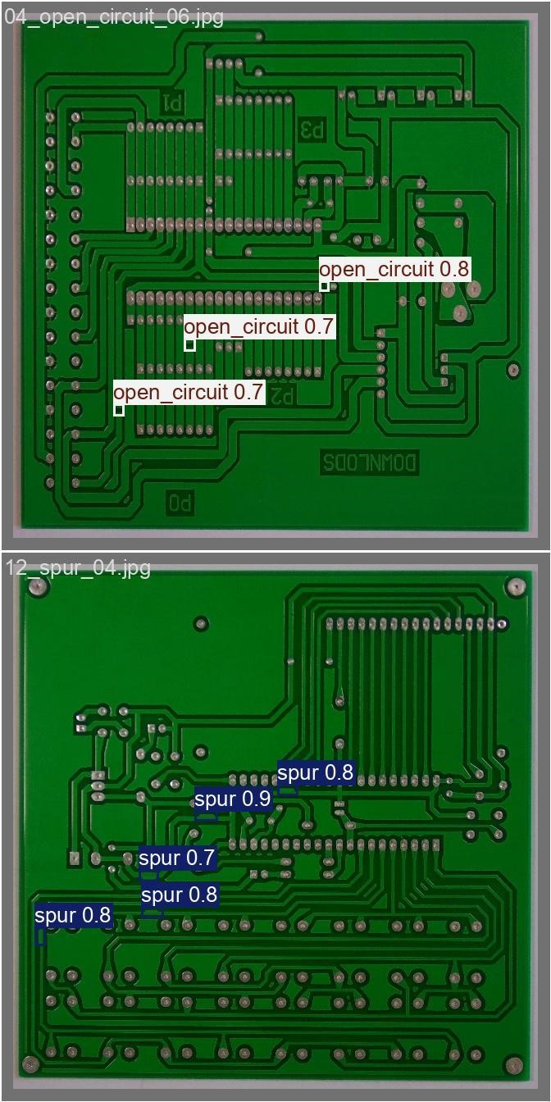
Results Yolov8

Slide 10
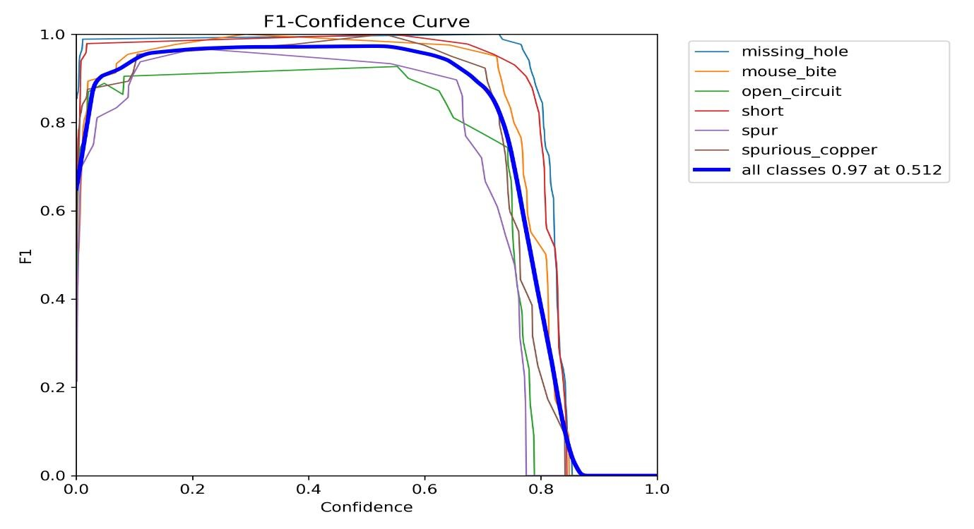
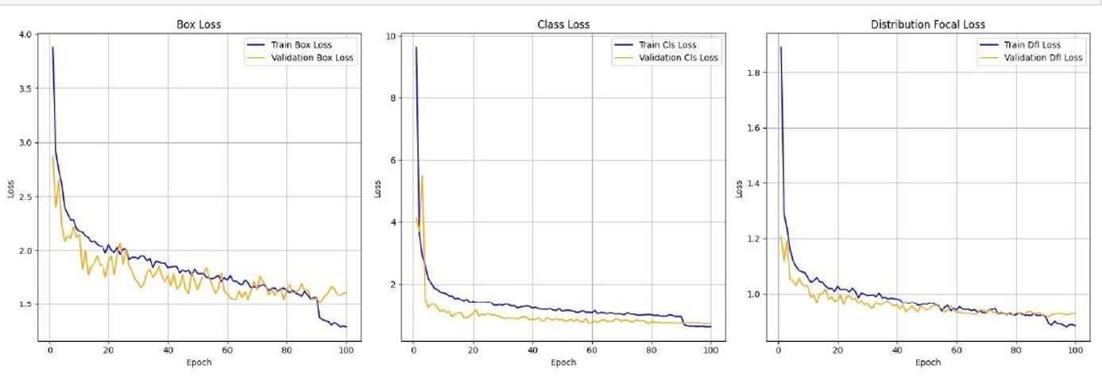
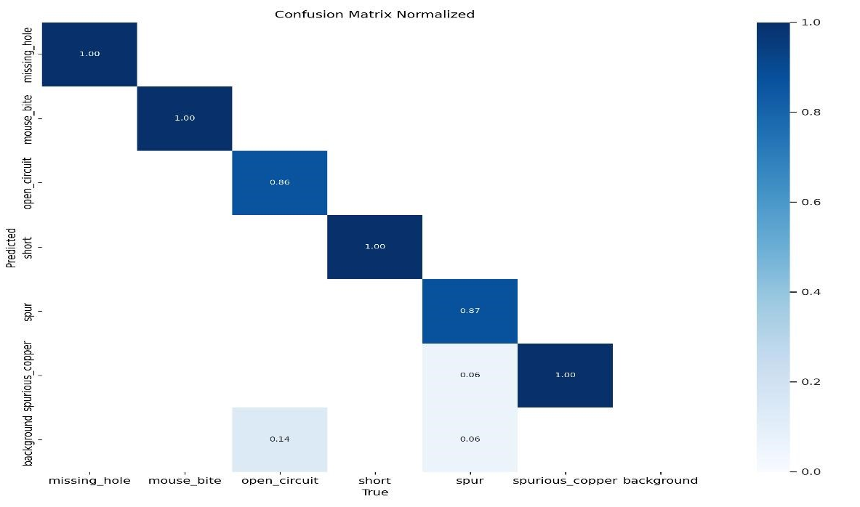
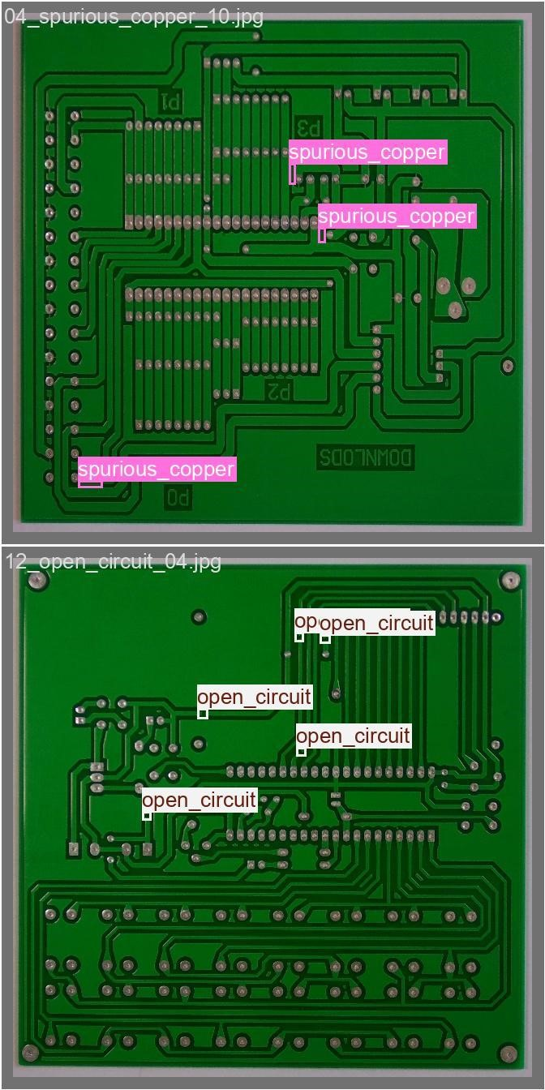
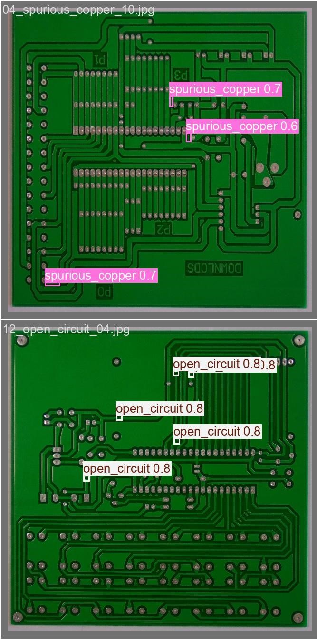
Results Yolov9

Slide 11
Comparison Yolov8 & Yolov9
Model | Box Loss | CLS Loss | DFL Loss | mAP
YOLO v8 | 1.55 | 0.706 | 0.906 | 97.5%
YOLO v9 | 1.61 | 0.698 | 0.926 | 96.8%

Slide 12
Risk Assessment and Mitigation Strategies
Model Bias Risk
Diverse Data training
Computational Risks
Efficient Computational solutions
Environmental Variations Risks
Robustness to Environmental variations
Regular Model retraining
Model drift Risk

Slide 13
Challenges
Handling XML Files
Time Limitation in Training
Detecting Multiple Defect Types

Slide 14
Future Work
Hyperparameter Tuning
Improved Datasets
Exploring Other Detection Algorithms

